Slide 1


Hotel Data Insights
Graduation Project
Supervisor: Prof. Ihab El Khodary

Slide 2


Team Members' Names
Abdelrahman Ahmed Barbary
Mohamed Yousef Abdelfatah
Aya Aboelsood Hamdy
Reham Ashraf fathy
Marwa Mahmoud Esmail

Slide 3
CONTENTS
1. Chapter 1: Introduction to the Project
2. Chapter 2: Data Exploration
3. Chapter 3: Customer Segmentation
4. Chapter 4: Time Series Forecasting
5. Chapter 5: Cancellation Forecasting
6. Chapter 6: Conclusion and Future Work

Slide 4

Chapter 1: Introduction to the Project

Slide 5

Introduction
Dataset of 140,000 hotel bookings
EDR and ADR dashboard
Key Areas of Focus
Customer Segmentation
Time Series Forecasting
Cancellation Forecasting

Slide 6



Project Overview
Importance of Data Analytics in Hospitality
Understanding customer preferences.
Optimizing pricing strategies.
Improving marketing efforts.
Enhancing operational efficiency.
Key Areas for Enhancement
Customer Segmentation and Personalization.
Forecasting Demand and Pricing.
Identifying Influential Factors on Average Daily Rate (ADR).

Slide 7


Problem Statement
Challenges in Hospitality
Ineffective customer segmentation.
Inaccurate demand forecasting.
High rates of booking cancellations.

Slide 8

Objectives
Forecasting Demand · Analyze historical data for demand patterns and develop dynamic pricing strategies.
Cancellation Forecasting
· Develop predictive models for cancellation rates.
Customer Segmentation and Personalization
· Analyze guest data and identify valuable segments.
.

Slide 9


Chapter 2: Data Exploration

Slide 10



Data Description
Dataset Overview
Data from two hotels in Portugal (2018-2020).
Total records: 140,950.
Data Features
· Booking details, guest information, reservation timing, room and service information, financial and pricing, reservation status.

Slide 11

Data Cleaning
Handling Missing Values
· Actions taken for missing values in children, country, agent, and company columns.

Slide 12


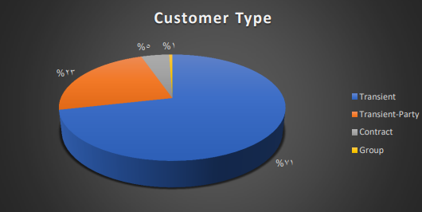
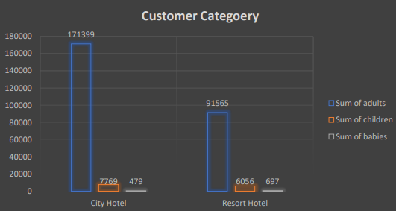
Exploratory Data Analysis
Customer Segmentation
Distribution of customer types and categories.
Insights on customer demographics and booking behaviors.
Distribution Channels
· Analysis of booking distribution across various channels.

Slide 13

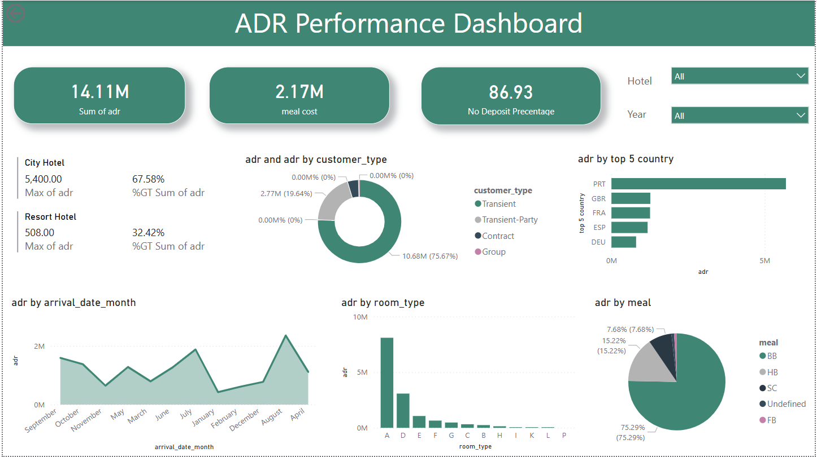
Average Daily Rate (ADR) Dashboard
1
Total ADR Performance
2
No-Deposit Percentage: 86.93% with a 26% Cancellation Rate
3
Meal Cost: $2.17M (Impact on Profitability)
4
ADR Trend by Month
5
Customer Type Impact on ADR
6
Top 5 Countries Driving ADR
7
Room Type Impact on ADR

Slide 14

Chapter 3: Customer Segmentation

Slide 15


Methodology
Preprocessing
· Sample selection and variable relevance.
Categorical to Cardinal Transformation
· Encoding categorical variables for analysis.
Feature Scaling
· Scaling dataset for uniformity.

Slide 16
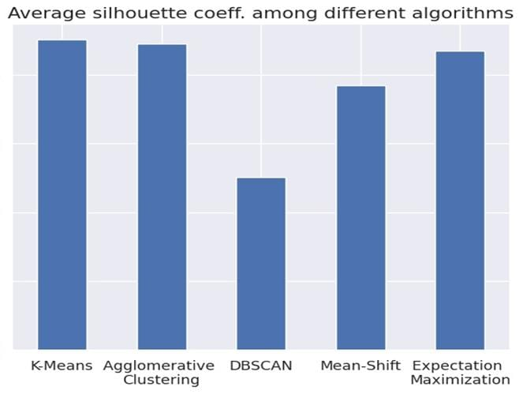

Modeling and Results
1
Dimension ality Reduction
· Use of PCA for feature reduction.
2
Modeling with K- Means Clustering
· Application of clustering algorithms and methods for determining cluster numbers.
3
Alternative Algorithms
· Use of other clustering algorithms for comparison.

Slide 17


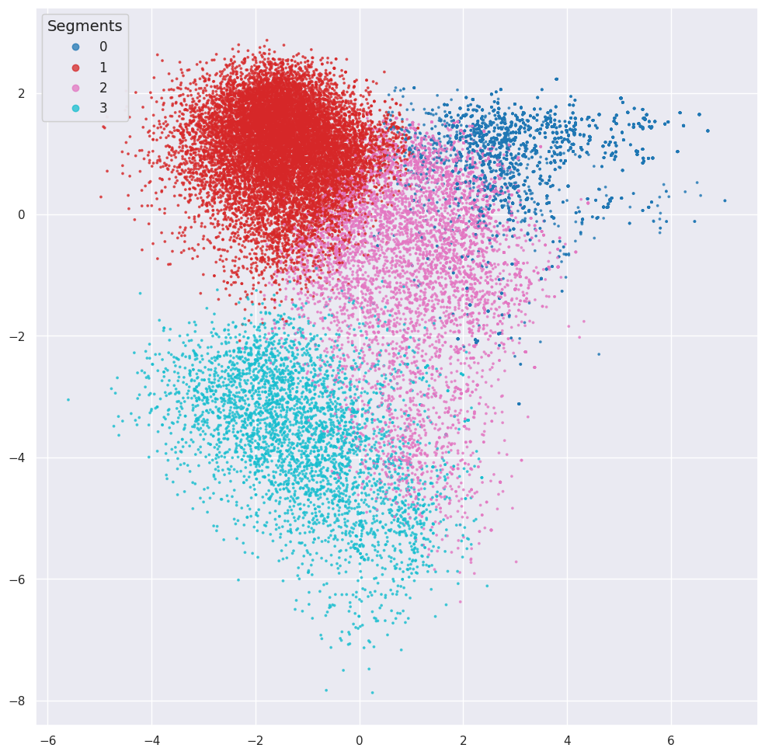
Visualize Results
Data Visualization
· Insights from PCA and clustering results.

Slide 18


Customer Segments Profiling
Segment Characteristics
segment 0: Likely represents group bookings made well in advance, with a higher cancellation rate.
segment 1: Represents last-minute bookings from other European countries, often through online TAs, with some special requests.
segment 2: Includes national customers booking through offline TA/TO, with shorter stays.
segment 3: Represents direct bookings at the resort hotel, with no deposits required.
.

Slide 19

Chapter 4: Time Series Forecasting

Slide 20


Introduction to Time Series Forecasting
Importance in Hospitality
· Benefits of accurate forecasting for pricing and customer experience.

Slide 21

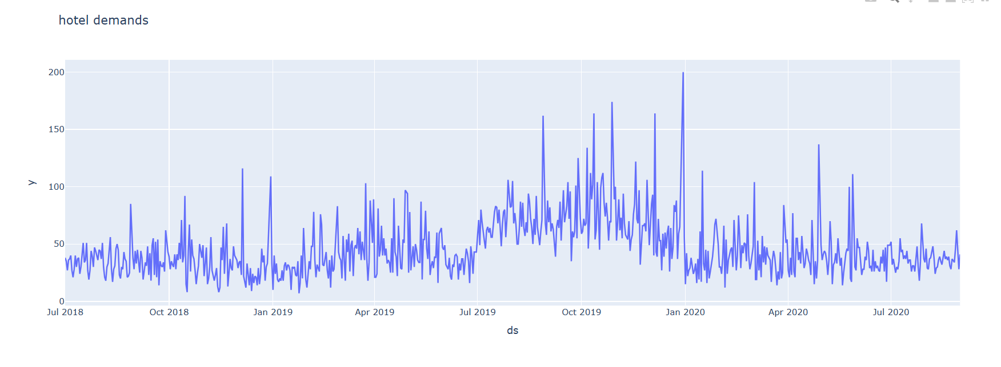
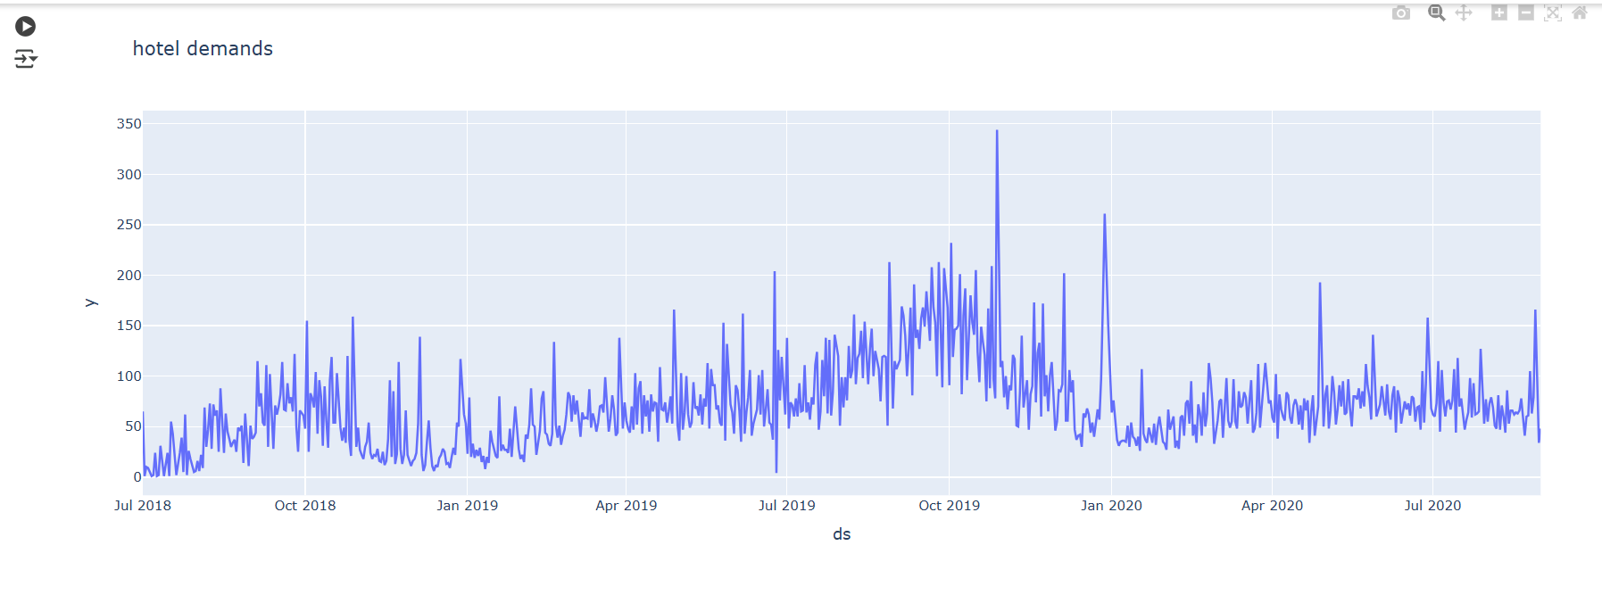
Hotels Demand
Resort Hotel
.
City hotel

Slide 22


Forecasting Techniques
ARIMA
Exponential Smoothing
Prophet

Slide 23

Model Selection and Evaluation
Performance Metrics
· Explanation of MAE and RMSE.

Slide 24
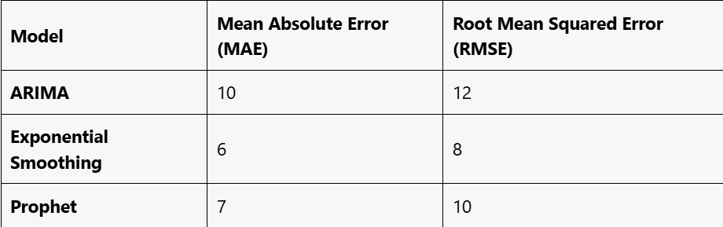
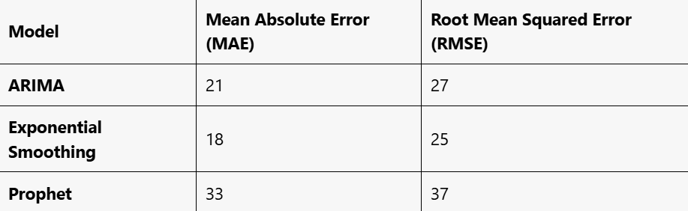
Performance Analysis
Model Performance Comparison
· Evaluation of forecasting models based on accuracy metrics.
Resort Hotel
City Hotel

Slide 25

Chapter 5: Cancellation Forecasting

Slide 26

Introduction to Cancellation Forecasting
Importance of Understanding Cancellations
Impact on Operations
Loss of Revenue
Operational Disruptions
Increased Marketing Costs

Slide 27

Data Collection and Preprocessing
Key Components of Data
Booking Patterns: Reservation dates & length of stay.
Customer Demographics: Characteristics affecting cancellations.
Historical Cancellation Data: Insights for predictive models
.

Slide 28

Preprocessing Steps
Handling Missing Values:
Removal of duplicates and incomplete records.
Feature Selection:
Correlation analysis and heatmap visualization.
Normalization Techniques:
Label Encoding for categorical variables.
Standard Scaling for numerical variables.
Addressing Class Imbalance
Utilized SMOTEN for balancing the dataset as follows:
Not Canceled: 73,961 instances
Canceled: 26,775 instances

Slide 29

Machine Learning Models
Overview of Machine Learning Models
Support Vector Machine (SVM)
Logistic Regression
XGBoost
Random Forest

Slide 30
Model Training and Evaluation
Training Process:
80% Training Set / 20% Testing Set.
Evaluation Metrics:
Focused on accuracy to assess model performance.
.

Slide 31
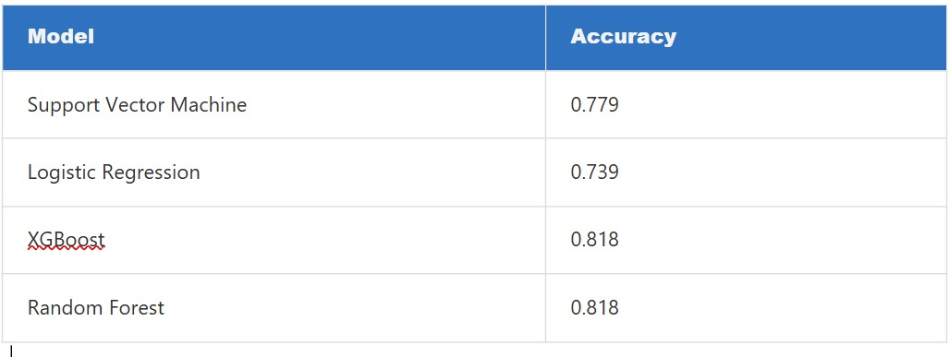
Results and Comparison
Model Performance Summary
.

Slide 32

Chapter 6: Conclusion and Future Work

Slide 33

Summary of Findings
Key Insights from the Project
· Customer segmentation, demand forecasting, and cancellation forecasting outcomes.

Slide 34

Implications for Hotel Management
Recommendations for Operational Improvements
· Enhanced segmentation, optimized pricing, and improved resource allocation.

Slide 35


Limitations of the Study
Identified Limitations
· Issues with causality, financial data, and customer behavior insights.

Slide 36

Future Direction
Areas for Further Research
· Workforce development, enhanced customer insights, and policy impact analysis.

Slide 37

Thank You

